Slide 1
Jet Set Willy 3: A New Beginning

Slide 2
Overview
‘Jet Set Willy 3: A New Beginning’ is the third unofficial sequel and homage to that of an icon to 80's British gaming. What I aim to create is a game that captures the original gameplay of the past games and build upon that a slight bit of combat and a small humorous story. The player must find any available money around the mansion, traverse many obstacles and avoid any enemies to help pay off the Taxman's debt.

Slide 3
What are we trying to do?
Resurrect an old, 80s, iconic gaming icon.
Mix classic with modern.
PC and beyond.

Slide 4
Gameplay
Newer Platformer that will be faster and contain more action than the original.
A bit of the ol’ punch ups.
Fluid camera and no longer flip screened.
Money is the key to success, not item collecting.

Slide 5

Characters
Main Characters:
Miner Willy
Andre
Maria
Enemies:
Taxman (Our main man!)
Repo Men
Party goers
The random things in the mansion

Slide 6
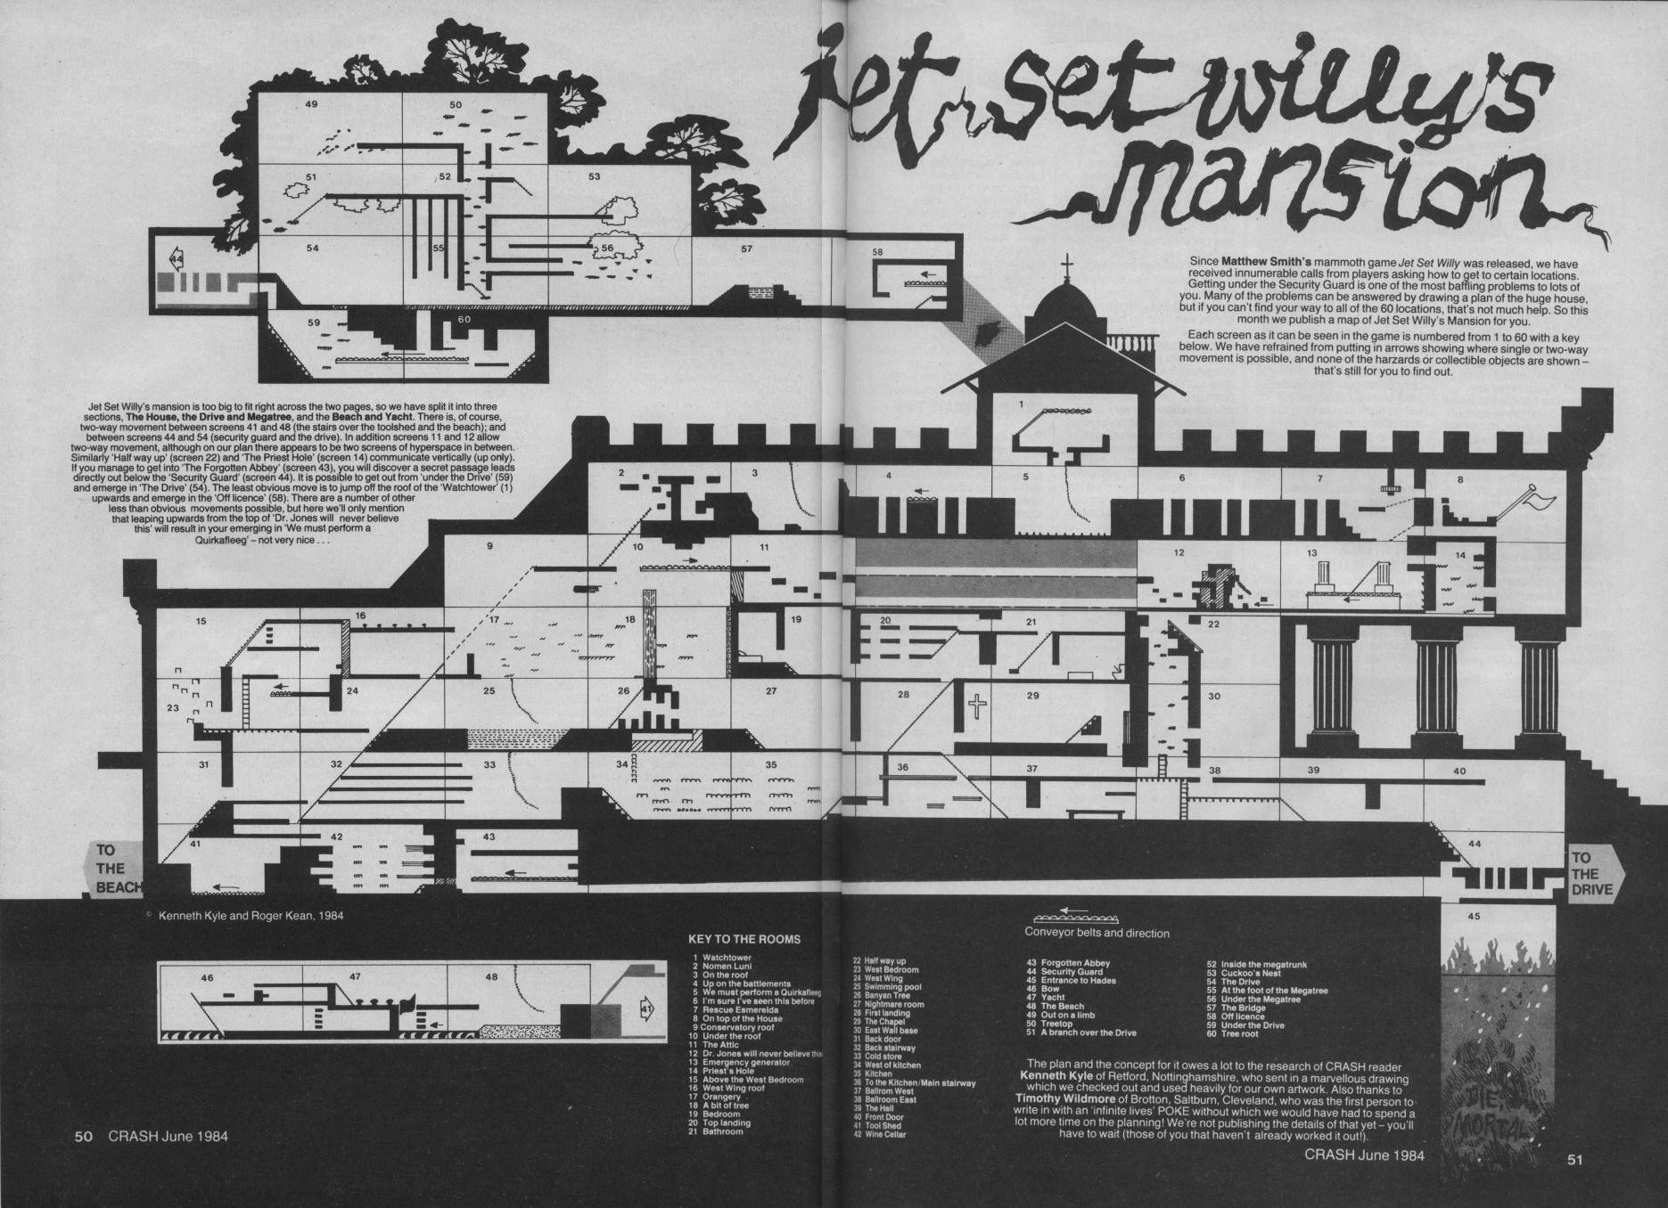
The mansion
The mansion will be larger than the original. Most areas retained or redesigned alongside newer areas.
A map alongside, room names popping up to help out with user’s navigation

Slide 7
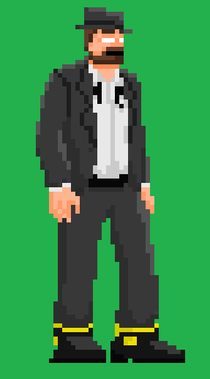
STYLE
Pixel art style, reminiscent of old arcade games.
No details spared because of the vast mansion.
Stuff constantly happening in the mansion.

Slide 8
MULTIPLAYER
Quick Jump-in and play style.
Up to 12 players.
Single player game but more challenging.
Players can choose any character and chat with others.

Slide 9

THANKS FOR WATCHING!

